Slide 1
#73 Gamification-based education platform
for sustainable agricultural and environmental applications
David Huang & Jesse Zeng
David Huang & Jesse Zeng
Notes:
Good morning, my name is Jesse and this is my partner David. We are doing project #73 which is about developing a gamification based education platform for sustainable agricultural and environmental applications.

Slide 2
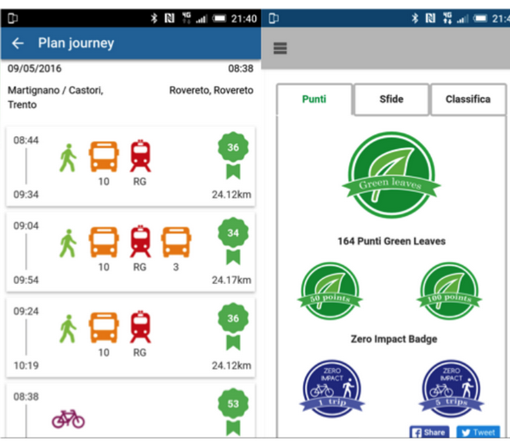
Gamification
“The use of game design elements in non-gaming contexts.” ¹
e.g. Points accumulation for using public transport
Project Focus
Spreading awareness and empowering people on an individual level
R. Kazhamiakin, A. Marconi, A. Martinelli, M. Pistore and G. Valetto, "A gamification framework for the long-term engagement of smart citizens", 2016 IEEE International Smart Cities Conference (ISC2), 2016.
[1] S. Deterding, R. Khaled, L. Nacke and D. Dixon, "Gamification: Toward a definition", 2011.
Notes:
We will be using gamification technology for our project. Gamification is the use of game design elements in non-gaming contexts. It entices people to do tasks or actions they otherwise may not do. An example of this is through rewarding users with points for using public transport instead of driving their car.
In this project we are investigating use of gamification to pass knowledge on sustainable agriculture. We are focusing on empowering individuals to make a change. During our research we found that there are attributes that define a successful gamification.

Slide 3
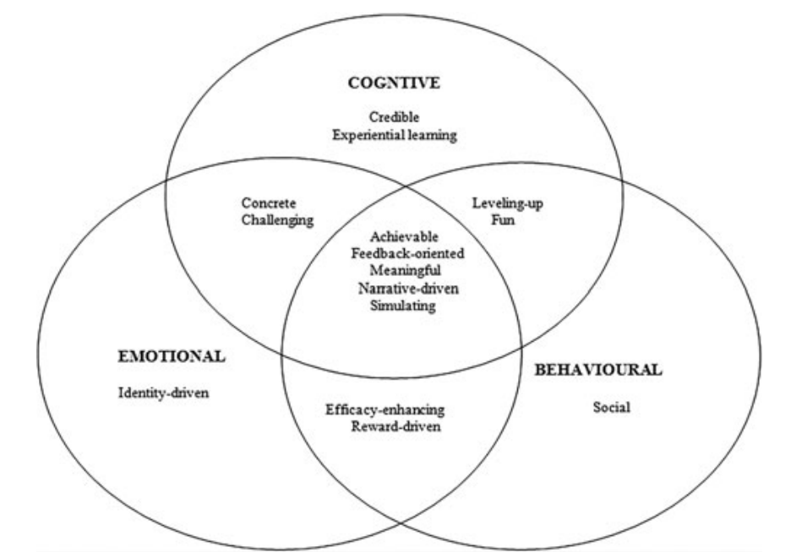
Games Framework
Credible knowledge
Experiential learning
Simulating
Rewards driven
Social Interaction
T. Ouariachi, M. Olvera-Lobo, J. Gutiérrez-Pérez and E. Maibach, "A framework for climate change engagement through video games", Environmental Education Research, vol. 25, no. 5, pp. 701-716, 2018.
Notes:
We discovered a gamification framework that proposed elements of successful user engagement in educational games. The games framework splits a number of attributes into 3 types of engagement. Within this framework, we have selected 5 key points to apply to our research : credible knowledge, experiential learning, simulating, rewards driven and social interaction. These key points define the analysis of our literature review in the next slide. And we will use the same attributes to evaluate our own research and implementation.

Slide 4
Literature Review Analysis
Points Collection Application
Points reward system to encourage sustainable actions
Contains
Reward driven
Social Interaction
Missing
Experiential learning
Simulation
Adapting to real world variables
Simulation Game
Educate and introduce players to farming in a virtual environment
Contains
Reward driven
Credible Knowledge
Experiential learning
Missing
Social interaction
Realism
Notes:
Our literature review analysis uncovered two common designs of gamification. The first design is a points accumulation app which reward points to users for choosing sustainable alternatives. However these points apps lacks experiential learning since it does not prioritise education but rather encourages more sustainable behaviours.
The second design is a simulation game. These games create a virtual environment representing reality that allows users to experience things they may not in real life. There are the Credible knowledge and Experiential learning attributes since players need to learn through trial and error. However, the simulation games reviewed had no social interaction due to a single player experience.
We also noticed that realism was a common missing factor. The points app does not account for real world variables for example it encourage users to bike even in bad weather conditions. And the simulation game lacks realism as it only deals with the virtual space. These factors leads to our research intent and objectives.

Slide 5
Research Intent: Augmented Reality Planting Game
Research Objectives
Use gamification to inform users about sustainable agricultural practices
Players grow an apple tree and learn through experiential learning
01
Knowledge
Realism
Augmented Reality (AR) creates a realistic learning environment for real world engagement
Use IoT weather data for real world constraints
02
03
Behaviour
Include transferable sustainability practices such as saving water
Notes:
Our research intent is to propose an Augmented reality planting game where players can learn about sustainable agriculture practices when growing their apple tree.
The first objective is to pass knowledge to users of our app. Our game will use experiential learning or trial and error to teach players how to grow the tree sustainably. Such as learning to use right amount of water and nutrients in the right frequency.
The second objective is to incorporate realism. We will use augmented reality where virtual space will provide virtual models and can be connected with the physical world using the camera. We will also implement (IoT) weather data so players are confronted with the real world constraints of farming.
Lastly our third objective is to have an impact on players behaviours and thoughts about sustainability. For example, through playing our game we hope that players can action the idea of using less water in their daily lives.
Next I will pass onto David who will continue with our app implementation demo.

Slide 6
Application Demo
Notes:
Hello my name is David and I will demoing our AR application. I will first introduce our app. And then I will evaluate the app based on the key points we selected from the games framework.
To begin with, the player must plant the seedling in a suitable surface.
When the player taps on the graph icon, they can see the water and nutrient levels of the plant.
As you can see, the levels are quite low so water and nutrients should be given to the seedling to start growing the apple tree.

Slide 7
Results
Player learns by growing the apple tree through the full life cycle
Results and feedback on how to improve are shown at the end
Experiential learning
Water and nutrient variables are based on agricultural knowledge
Learning about apple tree’s growth stages and diseases
Credible knowledge
Notes:
From here on, the player goes through a series of trial and error in order to understand how an apple tree grows.
For example, the player will soon understand that if the water and nutrient levels drops below a healthy amount, the growth slows down. However, if the plant receives no water or nutrient, the growth rate stops completely.
Additionally, if the plant receives no nutrients or water for a substantial amount of time, the apple tree dies. After this, feedback is given to the player on what caused the tree to die as well as graphs to show how the player’s actions contributed to the growth rate.
Overall, the player gains credible knowledge through experiential learning about the growth stages of an apple tree and the factors that can limit the tree’s growth rate.

Slide 8
Results
AR allows the user to see a realistic representation of the apple tree
The models and environment change depending on the state of the tree
Simulating
Player feel rewarded when reaching the next growth stage
Player is rewarded with apples at the final stage
Rewards driven
Notes:
Continuing on, as the player progresses further into the game, the player can see the growth cycles of the apple tree through the AR models.
The AR models can indicate the state of health of the tree.
For example,
If the tree has too much water, a wet soil model will appear.,
If the tree has a right amount of water, a default soil model will appear.
and finally, if the tree has too little water, a dry soil model will appear.
As the player becomes more knowledgeable in cultivating an apple tree, they are rewarded with the next growth cycle. If they reach the final stage, the player can finally harvest the apples. The amount of apples given to the user depends on the player’s performance.
Overall, our application gives a simulating realistic environment for the player as well as reward the player for their good performance.

Slide 9
Conclusions
Research Objectives
01
Knowledge
Apple tree death due to consequences of actions
Data (e.g graphs) to give players an informed decision
02
Realism
Semi-realistic apple tree models in AR
Linked weather data (rain and temperature) with apple tree growth
03
Behaviour
We intend to measure our behaviour research objective results through a user survey in the future.
Notes:
In conclusion, we have met the key objectives of knowledge and realism.
The player gains knowledge through the feedback given to them as they go through a series of trial and error.
For realism, the player feels like they are in a realistic learning environment due to semi-realistic AR models and realistic weather conditions that are sourced from a real life farm.
However, for the key objective of behaviour, we intend to measure this through user survey in the future to measure the impact and effectiveness of our implementation.

Slide 10
Future Directions
-> User Study
01
02
03
04
Expand Knowledge
Add More Player Actions
Expand Weather Data
Static Location for the Tree
Teach users more about sustainable agriculture
Over-fertilising
Overuse of pesticides
Preventing and managing apple tree diseases sustainably
Pruning
Pest control
Include more IoT data to model the real environment
Wind
Humidity
Sunshine hours
Use GPS location data to plant the virtual tree on real soil
Use location accurate weather data
Notes:
For the future direction of our research, we have identified 4 key ideas. The first idea is to broaden the knowledge we share in our app to teach more about sustainable agriculture. For example, we want to share that fertilising too much can pollute the environment and waterways.
The second idea is to add more actions that the player can do. Currently there is only watering and fertilising. We want to add more actions such as pruning and pest control in a sustainable way so that this knowledge can be applied to a real apple tree.
The third idea is to expand the weather data used in our app as only rainfall and temperature is used to calculate the tree’s growth at the moment. We also want to incorporate more factors such as wind, humidity and sunshine hours for a more comprehensive model of an apple tree’s growth.
Our fourth idea is to make a permanent location option for the virtual tree. For example, the apple tree could be set to a GPS location in your garden or anywhere in the world. We think this would make the planting more realistic.
We could also add a social feature where you could see other players’ trees.
Thank you for listening!

